Slide 1

“兼职桥”
兼职之路，畅通无阻
汇报人：管一超（G01）

Slide 2

1
项目基本信息
目 录
2
项目计划
CONTENTS
3
团队管理
4
参考文献

Slide 3


团队介绍
团队介绍
CONTENTS
KFBB团队，专注打造“兼职桥”项目，旨在简化兼职市场的招聘流程。我们的多领域专家致力于通过技术创新，解决信息不对称和信任问题，为求职者和雇主提供一个高效、可靠的平台。我们的目标是让兼职工作变得畅通无阻，让每个人都能轻松找到合适的机会。加入我们，共同推动兼职市场的繁荣发展。

Slide 4

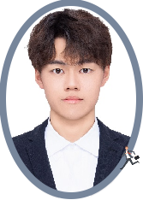

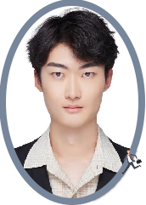
团队成员
项目经理--管一超
软件架构设计
后端设计
数据库设计
技术人员--杨凯俊
技术人员--朱昱洋
UI界面设计
单元测试
开发实现
系统维护
故障处理
用户支持

Slide 5


项目背景
背景介绍
兼职桥
在当今社会，兼职工作已成为许多人追求灵活生活方式的重要选择。随着经济的发展和人们对工作形式的多样化需求，兼职市场迅速扩大。然而，求职者和雇主之间的信息不对称、沟通成本高以及招聘流程繁琐等问题，常常导致兼职工作难以高效匹配。我们的“兼职桥”项目旨在打破这些屏障，通过智能化的匹配系统，帮助求职者轻松找到合适的兼职工作，同时也为雇主提供便捷的招聘渠道。
P
L
A
N

Slide 6

主要里程碑
2024.9.10-2024.9.30
用户需求分析
需求分析
系统架构设计
2024.9.30-2024.10.31
数据库设计
项目设计
后端设计
前端开发
2024.11.1-2024.11.31
前端设计
P
后端开发
项目开发
L
2024.12.1-2024.12.30
单元测试
A
前后端集成
N
项目测试
集成测试
2025.1.1
上线验收
功能测试
上线维护
维护

Slide 7

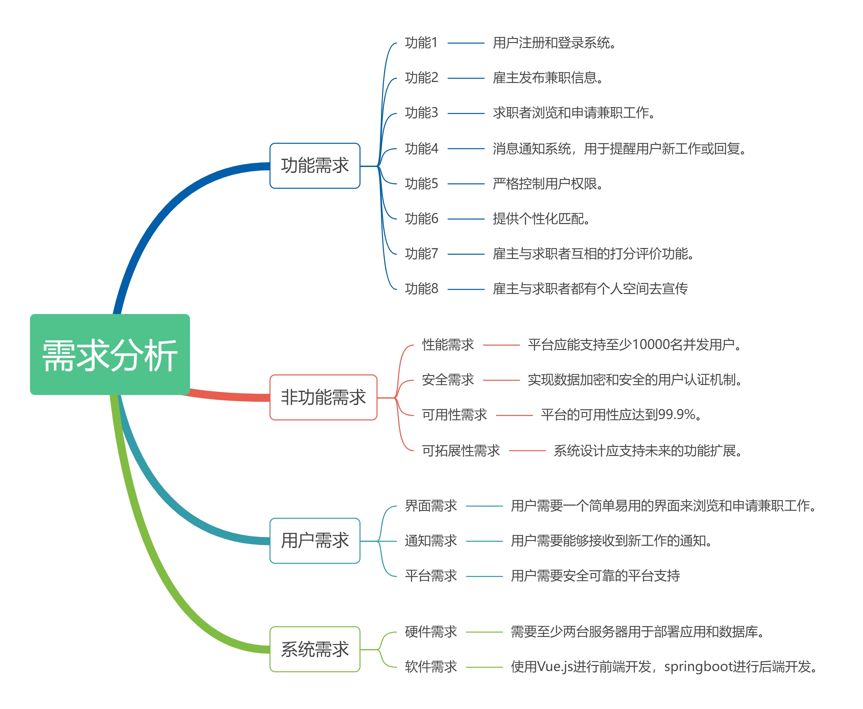
需求分析

Slide 8
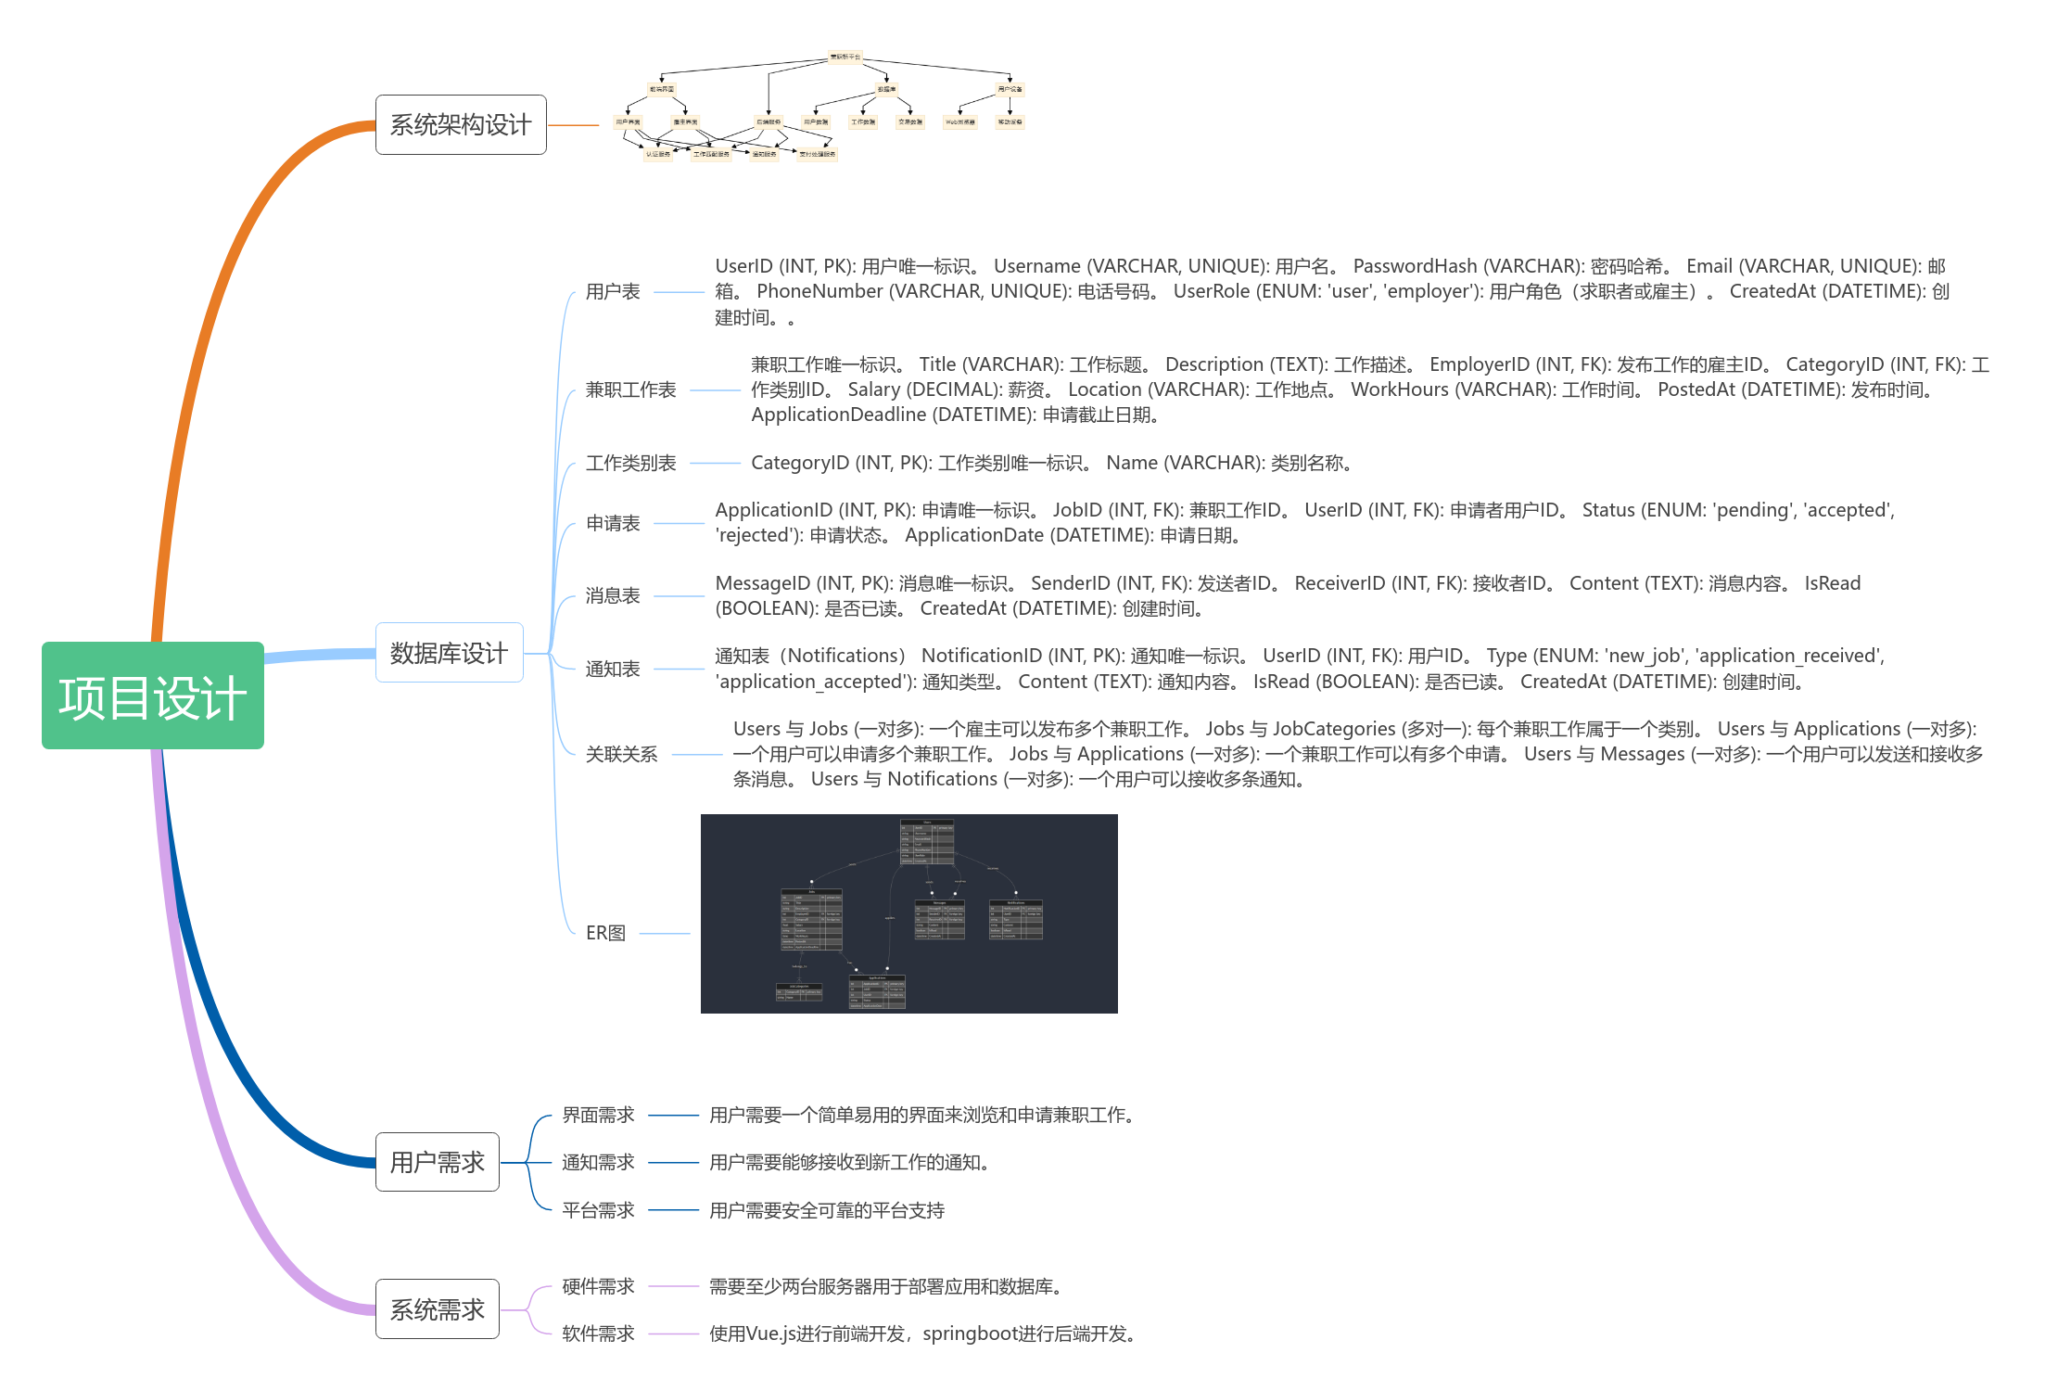
项目设计

Slide 9
发展历程
P
历程简述
L
Defined 点击输入简要文字内容，文字内容需概括精炼，不用多余的文字修饰，言简意赅的说明分项内容……
A
目前阶段
N
YOUR NORMAL TEXT | HERE
20XX
成立阶段
编辑标题
Defined as a greater likelihood that users will share content posted to their social network .
YOUR NORMAL TEXT | HERE

Slide 10
理念
标 题
编辑简明扼要的说明文字
LOGO
标 题
编辑简明扼要的说明文字
P
P
L
L
编辑标题
A
A
标 题
N
Defined as a greater likelihood that users will protect content for their social network many social 稻壳尤巍设计原创 provide specific functionality to help users uwaydesign .
N
编辑简明扼要的说明文字

Slide 11

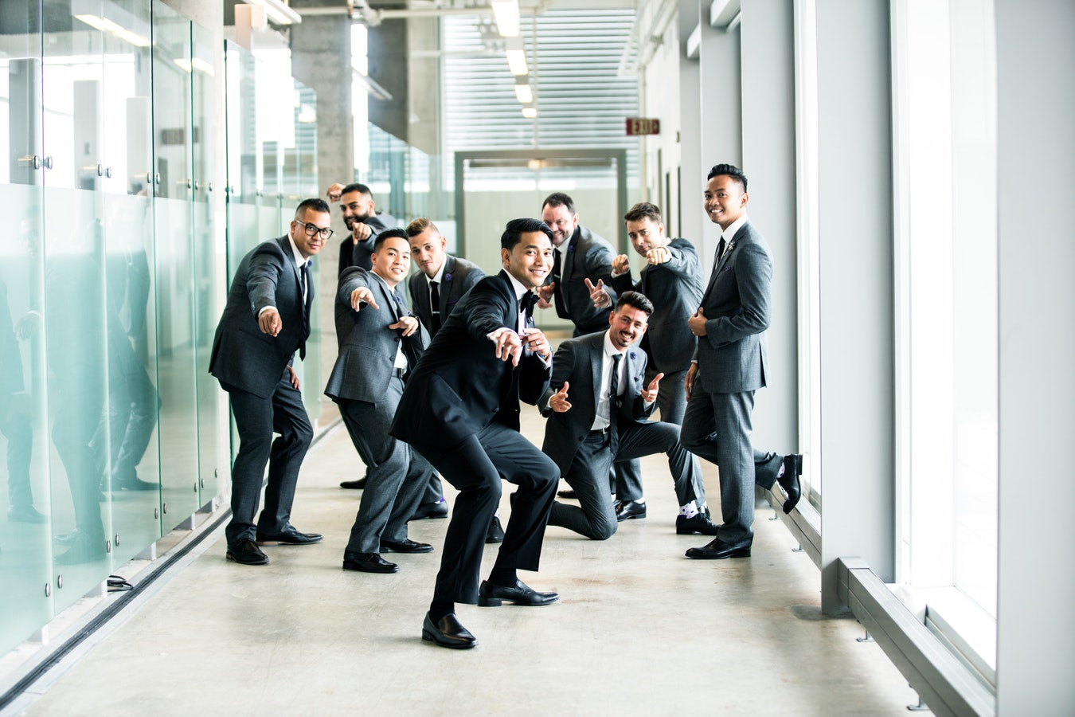
团队成长
编辑标题
Defined as a greater likelihood that users .
Defined as a greater likelihood that users will share content posted to their social network .
Defined as a greater likelihood that users will share content posted to their social network .
P
L
A
N

Slide 12

产品与服务
服务范围
产品展示
行业水平
技术壁垒
P
CONTENTS
Defined as a greater likelihood that users will share content posted to their social network .
L
A
N

Slide 13
行业水平
编辑标题
Defined 点击输入简要文字内容，文字内容需概括精炼，不用多余的文字修饰，言简意赅的说明分项内容……
82%
P
L
营销优势
A
Defined 点击输入简要文字内容，文字内容需概括精炼，言简意赅的说明分项内容……
N

Slide 14
提供两种列表方式任选
>
右侧内容可换
Defined as a greater likelihood that user .
>
编辑精炼演示内容文本
编辑标题
YOUR NORMAL TEXT | HERE
服务
POINT TITLE
YOUR NORMAL TEXT | HERE
编辑标题
YOUR NORMAL TEXT | HERE
Defined as a greater likelihood that users .

Slide 15
技术壁垒与水平 PROJECT
行业水平
P
Defined as a greater likelihood that users will share content posted to their social network many social media sites provide specific functionality to help users share content .
L
A
N
专利名称
技术名称

Slide 16
案例与荣誉
案例展示
典型案例
数据展示
行业荣誉
P
CONTENTS
Defined as a greater likelihood that users will share content posted to their social network .
L
A
N

Slide 17

经典案例
P
公司经典案例
L
2018年规模最大案例 likelihood that users will share content posted to their social network many social media sites provide specific functionality.
A
POINT TITLE
N
YOUR NORMAL TEXT | HERE
编辑标题
Defined as a greater likelihood that users will share content posted to their social network .
YOUR NORMAL TEXT | HERE

Slide 18




案例
展示
P
L
A
N

Slide 19
荣誉
介绍
优势荣誉
Defined as a greater likelihood that users will share content posted to their social network .
优势荣誉
Defined as a greater likelihood that users will share content posted to their social network .
P
L
A
优势荣誉
荣誉
N
Defined as a greater likelihood that users will share content posted to their social network .

Slide 20
三要素
通用
WORK
POINT TITLE
YOUR NORMAL TEXT | HERE
2018
标题
2020
P
L
POINT TITLE
POINT TITLE
A
YOUR NORMAL TEXT | HERE
N
Defined as a greater likelihood that users will share content posted to their social network many social.

Slide 21
数据展示
数据展示页面
Defined as a greater likelihood that users will share content posted to their social network many .
82%
62898
P
L
数据标题
A
Defined as a greater likelihood that users will share content posted to their social network greater likelihood that users .
N
9月
10月
11月
12月
数据类型
数据类型

Slide 22
规划与战略
发展战略
发展历程
未来规划
合作伙伴
P
CONTENTS
Defined as a greater likelihood that users will share content posted to their social network .
L
A
N

Slide 23
战略规划
96%
82%
演示数据
TARGET
以上为拟演示数据
TARGET TITLE
P
L
A
N

Slide 24
层次提升
STAGE 1
STAGE 2
STAGE 3
编辑标题
编辑标题
编辑标题
Defined as a greater likelihood that users will share content posted to their social network .
Defined as a greater likelihood that users will share content posted to their social network .
Defined as a greater likelihood that users will share content posted to their social network .
P
L
A
N

Slide 25

发展
展望
编辑标题
Defined as a greater likelihood that users will share content posted to their social network many social media sites provide specific functionality to help users share content .
P
L
POINT TITLE
POINT TITLE
A
2018
2020
N
2019
2021
POINT TITLE
POINT TITLE

Slide 26
态势分析
优势分析
劣势分析
创造机会
威胁应对
Defined as a greater likelihood that users will do share content stev posteto their social sf network man social media sites provide .
Defined as a greater likelihood that users will do share content stev posteto their social sf network man social media sites provide .
Defined as a greater likelihood that users will do share content stev posteto their social sf network man social media sites provide .
Defined as a greater likelihood that users will do share content stev posteto their social sf network man social media sites provide .
U
W
www.docer.com
A
Y

Slide 27

战略合作
品牌战略合作伙伴
人的视觉习惯决定了主体应该在的地方
明确的精炼主题
W
明确的精炼主题
P
人的视觉习惯决定了主体
应该在的地方
人的视觉习惯决定了主体
应该在的地方
L
A
N
FORCE
明确的精炼主题
人的视觉习惯决定了主体应该在的地方

Slide 28

案例展示页 | 产品服务PK页
Defined as a greater likelihood that users will share content posted to their social network .
P
L
P
A
L
N
A
案例
展示
N

Slide 29
项目列表
TITLE | TITLE | TITLE | TITLE
UWAY
UWAY
UWAY
UWAY
UWAY
UWAY
UWAY
www.docer.com
P
L
近期项目与工作列表
A
N

Slide 30
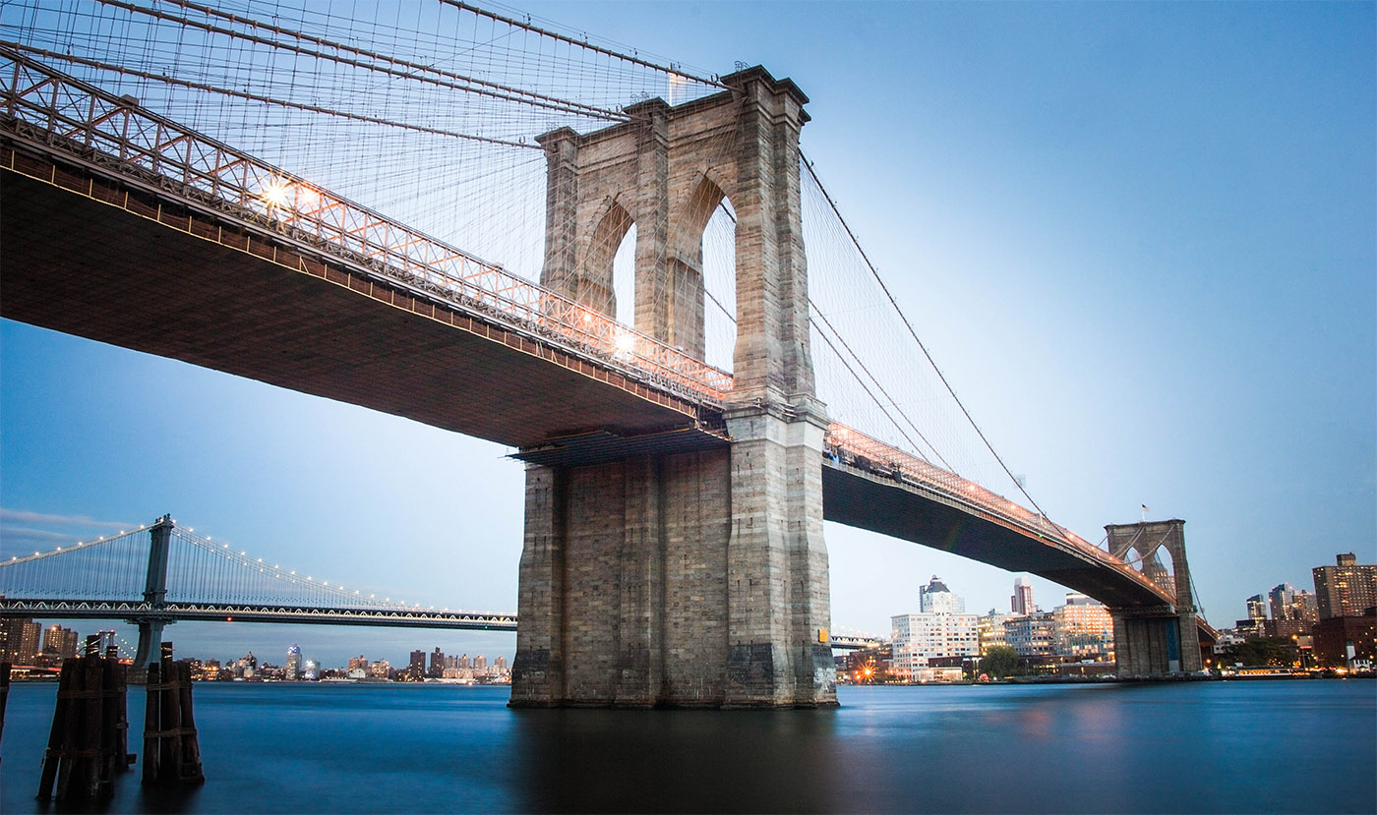
结语
稻壳儿尤巍设计
尤巍设计仅在稻壳有店铺
尤巍设计经历了10年设计行业中的打磨与锻炼，始终如一的在做一件事情，擅长于专业PPT定制设计，各类商业与个人PPT设计与制作，信息化比赛PPT，互联网+PPT，企业公司介绍PPT，工作总结PPT，项目计划PPT，课件PPT等，欢迎进入尤巍设计的稻壳儿店铺查看更多作品！
P
L
P
A
L
N
A
N

Slide 31
汇报完毕
尤巍设计
P
企业展示全目录模板
L
A
N
汇报人：尤巍设计

Slide 32
UWAY
尤巍原创
稻壳独家
店铺地址
http://chn.docer.com/works/?userid=2163346&channel=mall_detail_designer&sub_channel=mall_designer#!/work_dl

Slide 33
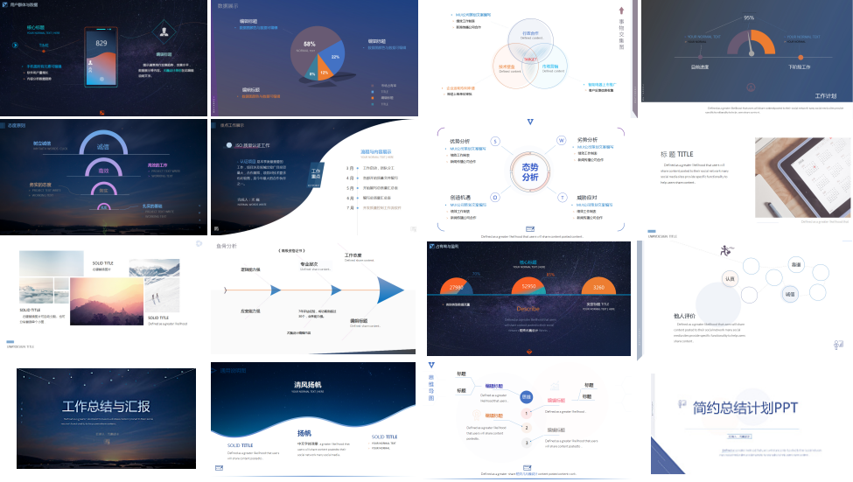


稻壳独家
尤巍原创
欢迎搜索并持续关注稻壳儿 尤巍设计，或复制以下链接至浏览器进入店铺查看更多作品！
http://chn.docer.com/works/?userid=2163346&channel=mall_detail_designer&sub_channel=mall_designer#!/work_dl

Slide 34
稻壳独家原创

